Slide 1
Data Structures and Algorithms
Notes:
To create Em dash above headline:
Same size and weight as the headline and set using a soft return.
PC: Em dash (—): Alt+Ctrl+ - (minus)
Mac: Em dash (—): Shift+Alt/Option+hyphen

Slide 2
Agenda
Overview of the course
What is an algorithm and why study it
Abstract data types
Data structures
Summary

Slide 3
1. Overview of the Course
Notes:
To create Em dash above headline:
Same size and weight as the headline and set using a soft return.
PC: Em dash (—): Alt+Ctrl+ - (minus)
Mac: Em dash (—): Shift+Alt/Option+hyphen

Slide 4
A Bit about Me
Name: Yossi Nygate
Where I have worked
RIT, Associate Professor, College of Engineering Technology (USA) – 5 years
Amdocs, CTO and Vice President of Architecture (Israel and Singapore) – 12 years
Nortel, Director of Network Engineering (Canada and Israel) – 5 years
AT&T Bell Labs, Software Engineer (USA, Japan and France) –13 years
Israeli Army – Combat engineer, mines and demolition – 3 years
Where I have studied
PhD in Computer Engineering, Case Western Reserve University, USA
MSc in Computer Science and MSc in Applied Mathematics, Weizmann Inst., Israel
BSc in Computer Science, Ben-Gurion University, Israel

Slide 5
Course goals
Theory:
Learn a variety of algorithms and data structures
Understand how to estimate running times of algorithms
Practice:
Understand how to measure algorithm complexity and performance empirically
Learn to implement various algorithms and data structures to solve a variety of problems

Slide 6
Why?
Simple answer:
We want to solve problems, so we need to have the tools (algorithms)
We want to select the right tools, hence the need to understand how the tools work and how efficient they are
It makes you a better problem solver and programmer!

Slide 7
Requirements
This course has code examples in Java and Python
This course is not about programming, but we do need a language for the practical parts
You can submit your answer using either Java or Python
At a minimum, you should be comfortable with:
Basic data types and structures
Defining new classes and data types
Inheritance and polymorphism

Slide 8
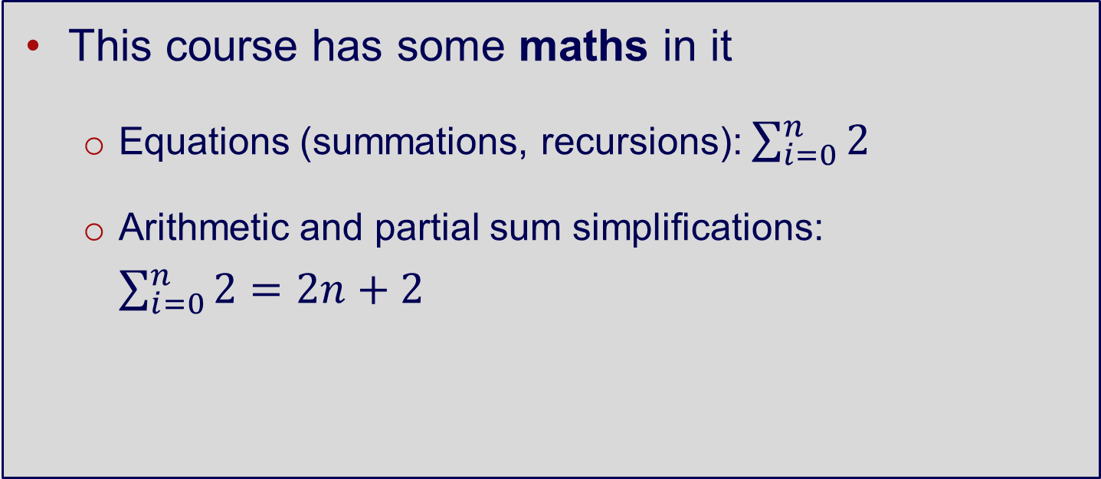
Mathematics
This course has some maths in it
Equations (summations, recursions): $\sum_{i=0}^{n}{2}$
Arithmetic and partial sum simplifications: $\sum_{i=0}^{n}{2=2n+2}$
Notes:
We need to count how many times certain operations occur to analyse algorithms

Slide 9
Assessments
Individual – 60%
Assessment 1 (20%)
Algorithm Implementation
Assessment 2 (20%)
Algorithm Design and Implementation
Assessment 3 (20%)
Problem Solving Activity
Group of 2 to 3 students – 40%
(exception can be granted)
Assessment 4 (40%)
Group Project

Slide 10
Housekeeping
Course will be a combination of lectures and labs
Ratio will vary
Come to class on time
Please don’t disturb your classmates
Loud chatting
Phone calls
Be professional

Slide 11
I am here to help
Please do NOT wait until the day before the due date…
To submit your assignment
To seek help
Extensions are only granted in exceptional circumstances
Early Assessment will be provided on Assignment 1
Be sure to read Course Announcements

Slide 12
How to Contact Me
Email: yossi.nygate@rmit.edu.vn
Office Hours: Tuesday afternoons or Friday mornings
Please email for appointment in advance to avoid clashing with other students
You can also contact me via canvas

Slide 13
Course syllabus
Week | Topic | Assessment
1 | Introduction to Data Structures and Algorithms
2 | Algorithms Analysis and Design
3 | Arrays and Lists | Assessment 1 (20%)
4 | Queues and Stacks
5 | Trees
6 | Time and Space Trade-offs | Assessment 2 (20%)
7 | Independent Learning Week

Slide 14
Course syllabus
Week | Topic | Assessment
8 | Brute Force
9 | Divide and Conquer | Assessment 3 (20%)
10 | Decrease and Conquer
11 | Christmas Break
12 | Transform and Conquer | Assessment 4 (40%)
13 | Advanced Topics

Slide 15
Grading
I will finish grading within 7 business days after the due date (weekends are generally excluded)
Personalised feedback are provided via canvas (if group assignment please contact group leader/submitter for feedback)

Slide 16
Learning objectives
This week’s learning outcomes:
Understand the concept of algorithms and data structures, and the motivation behind their analysis
Learn about different abstract data types and data structures

Slide 17
2. What is an algorithm and why study it

Slide 18
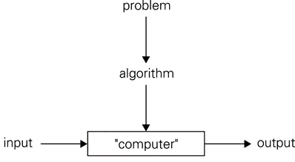
What is an algorithm
An algorithm is a sequence of (unambiguous) instructions/steps for solving a problem

Slide 19
What is an Algorithm?
An algorithm should be:
Independent of programming language
A finite, deterministic and effective problem-solving method
What algorithms do you know?
Do you know where the word algorithm comes from?

Slide 20
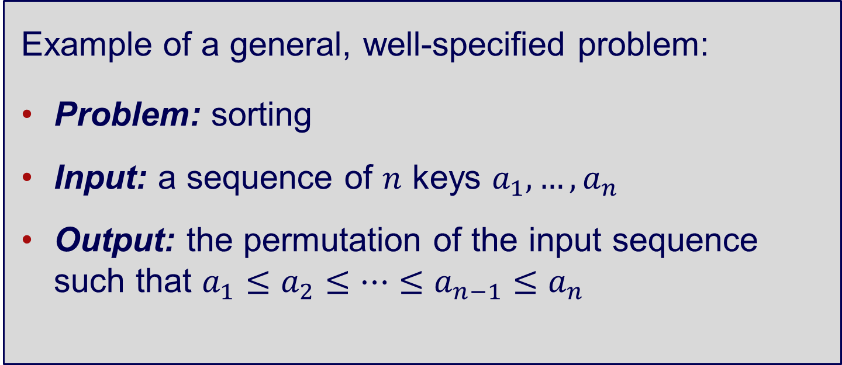
What is an Algorithm?
Example of a general, well-specified problem:
Problem: sorting
Input: a sequence of $n$ keys $a_{1},…,a_{n}$
Output: the permutation of the input sequence such that $a_{1}≤a_{2}≤…≤a_{n−1}≤a_{n}$

Slide 21
Algorithms for Problem Solving
You have a 3 and a 5 liter water container, each container has no markings except for that which gives you it's total volume. You also have a running tap. You must use the containers and the tap in such away as to exactly measure out 4 liters of water
How is this done?
Can you generalize the form of your answer?

Slide 22
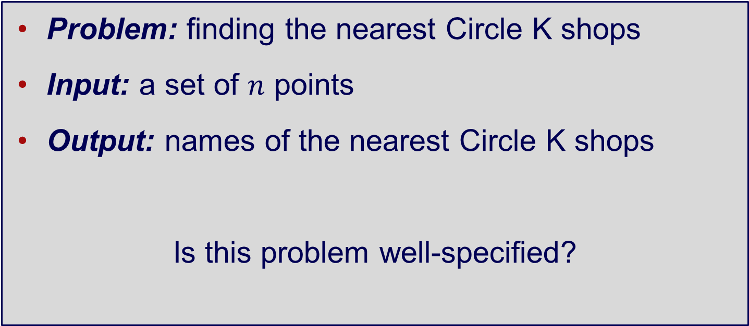
What is an algorithm
Problem: finding the nearest Circle K shops
Input: a set of $n$ points
Output: names of the nearest Circle K shops
Is this problem well-specified?

Slide 23
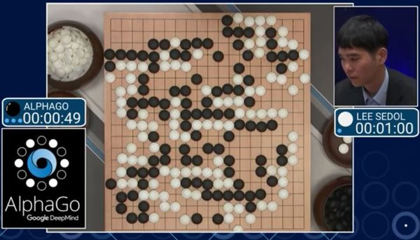
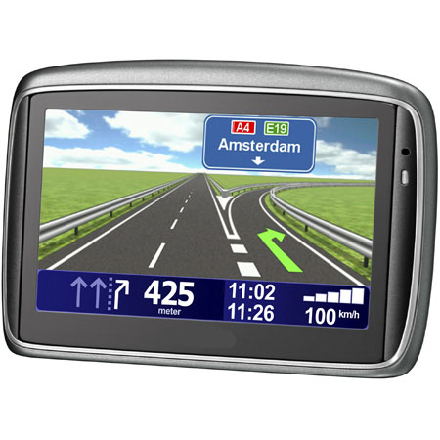

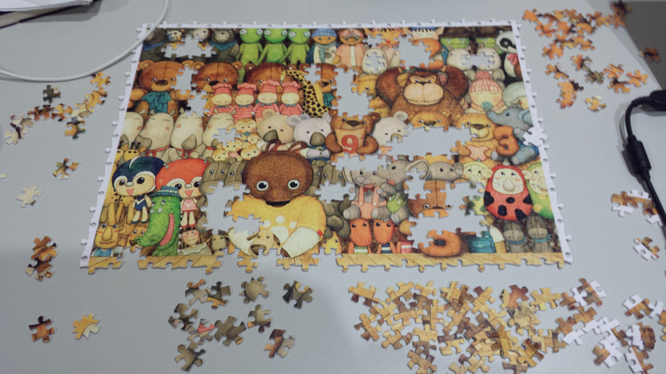

Examples of algorithms

Slide 24
Example: Euclid’s algorithm
Find gcd(m, n), or the greatest common divisor* of two non-negative integers m and n
Examples:
gcd(60,24) = 12
gcd(60,0) = 60
gcd(0,0) = ?
* 6 (dividend) / 3 (divisor) = 2 (quotient)
Notes:
the largest common divisor of k and zero is k. So gcd(k, 0) = gcd(0,k) = k. However,gcd(0, 0) isn't defined. All integers are common divisors of 0 and 0, so there is no greatest one.

Slide 25
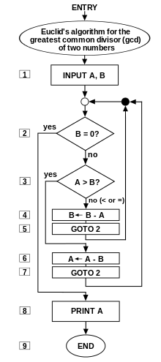
An Example Algorithm
Euclid’s algorithm for calculating the greatest common divisor (GCD) of two numbers a and b in locations named A and B
How well does this algorithm perform when A and B are about the same size or if they are very different sizes?

Slide 26
Euclid’s algorithm–solution
Euclid’s algorithm is based on repeated application of the equality: gcd(m, n) = gcd(n, m mod n)
until the second number n becomes 0 (no remainder)
The answer is then the first number m
Example: gcd(60;24) = gcd(24;12)
= gcd(12;0) = 12
Notes:
the largest common divisor of k and zero is k. So gcd(k, 0) = gcd(0,k) = k. However,gcd(0, 0) isn't defined. All integers are common divisors of 0 and 0, so there is no greatest one.

Slide 27
Euclid’s algorithm–pseudocode
ALGORITHM Euclid(m, n)
// Computes gcd(m, n) by Euclid’s algorithm
// INPUT: two non-negative integers m and n
// OUTPUT: greatest common divisor of m and n
if n > 0 then
return gcd(n, m mod n)
end if
return m
Notes:
the largest common divisor of k and zero is k. So gcd(k, 0) = gcd(0,k) = k. However,gcd(0, 0) isn't defined. All integers are common divisors of 0 and 0, so there is no greatest one.

Slide 28
Euclid’s algorithm–implementation
public static int gcd(int a, int b)
{
if (b == 0)
return a;
return gcd(b, a % b);
}
Any alternative approach to this problem?

Slide 29
GCD alternative – common primes
Step 1: Find the prime factors of m
Step 2: Find the prime factors of n
Step 3: Identify all the common factors in the two prime expansions from Step 1 and Step 2
Step 4: Compute the product of all common factors and return it as the greatest com

Slide 30
GCD alternative – common primes
Example:
60 = 2 x 2 x 3 x 5
24 = 2 x 2 x 2 x 3
gcd(60,24) = 2 x 2 x 3 = 12
Is it more “efficient”?

Slide 31
Some Questions
An array A of length n contains a random mix of positive and negative integers. Describe an algorithm that rearranges these integers so that the negative integers appear before the positive integers. You may use additional variables as indices or for storing temporary values, but no additional arrays can be allocated or used.
An array A of length n contains positive and negative integers. Describe an algorithm that will find a place in an array where the sum of all the integers to the left equals the sum of all the integers to the right

Slide 32
Motivation for studying algorithms
Watch this video
https://www.khanacademy.org/computing/computer-science/algorithms/intro-to-algorithms/v/what-are-algorithms

Slide 33
2. Abstract data types

Slide 34
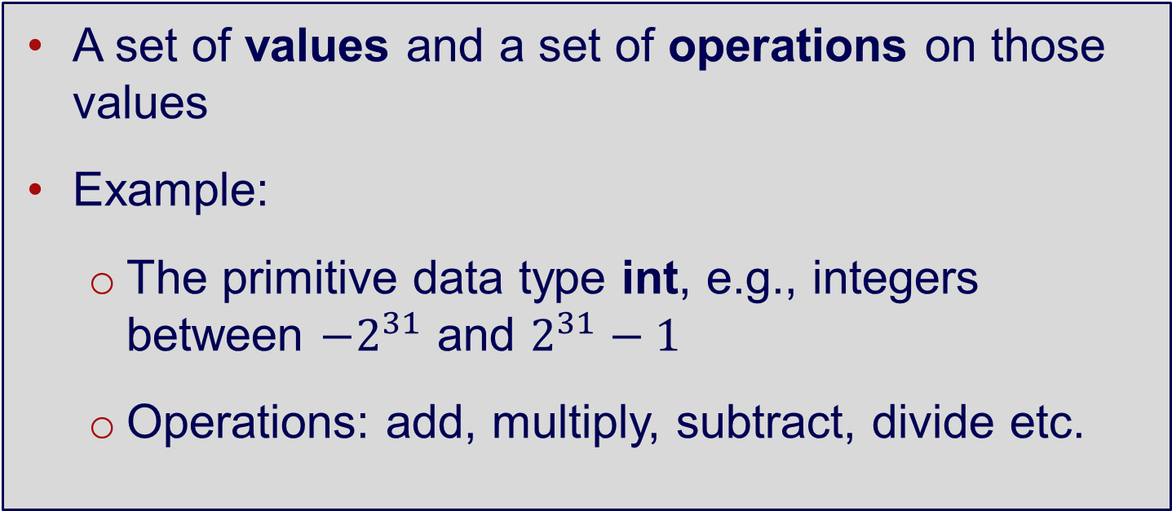
Data Type
A set of values and a set of operations on those values
Example:
The primitive data type int, e.g., integers between $−2^{31}$ and $2^{31}−1$
Operations: add, multiply, subtract, divide etc.

Slide 35
Built-in Data Types
All programming languages provide built in Data Types
Example – a floating number allows us to use operations such as assignment, input, output, arithmetic operations without knowing the internal representation
Many programming languages allow us to create our own user defined data types and define variables of those new data types
Picking the right one for the job is an important step in design
Get your data structures correct first, and the rest of the program will write itself

Slide 36
Abstract Data Type (ADT)
You can define your own data types
This is called data abstraction
ADT is a data type whose representation is hidden from the client
Operations are accessed through an interface

Slide 37
Abstract Data Types (ADT)
ADT defines the logical form of the data type (i.e., the user’s view), whereas data structure implements the physical form of the data type (i.e., the implementer’s view)
Integer is an ADT. It is defined by a set of values (e.g., 0, 1, 2, 3) and a set of operations (e.g., add, subtract)
Bit vectors (e.g., 11100101) is a data structure. It is an implementation of integer.

Slide 38
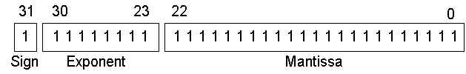
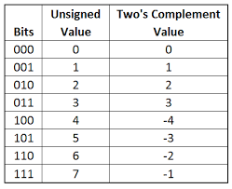
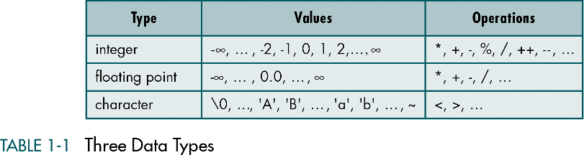
Abstract Data Types
Characters –ASCII
Integers – two’s complement
Floating point

Slide 39
What is Data Abstraction
One of the most powerful programming paradigms
A representation of data and the operations allowed on that data
Separates the purpose of a module from its implementation
Asks you to think what you can do to data independently of how you do it
Allows you to develop each data structure in relative isolation from the rest of the solution
Hides implementation details within a module
We think about what operations can be performed on a particular type of data and not how it does it

Slide 40
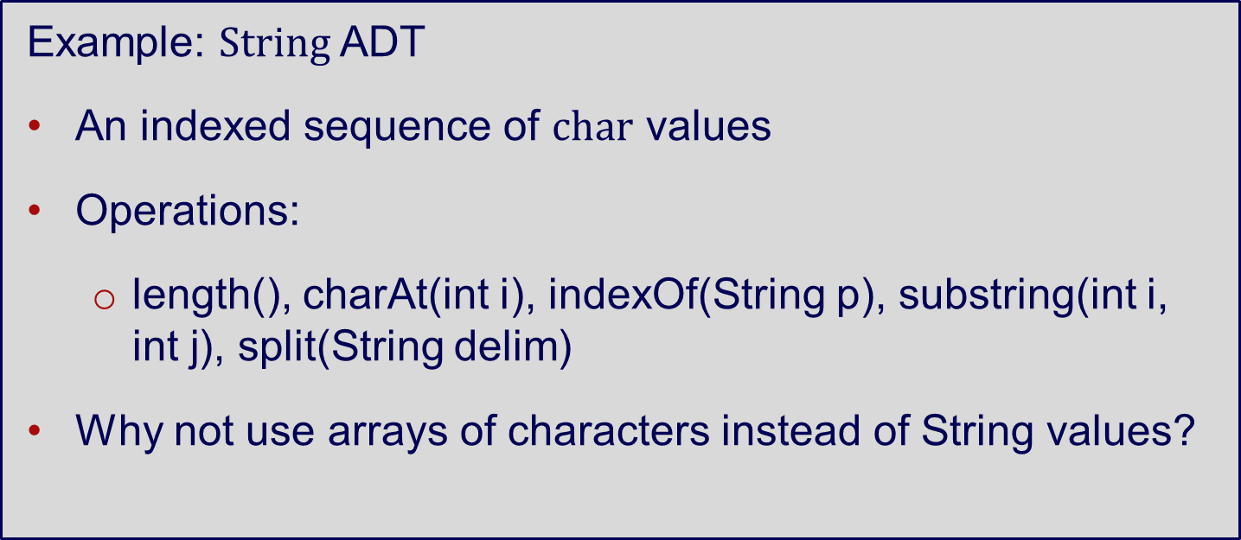
Abstract Data Type (ADT)
Example: $String$ ADT
An indexed sequence of $char$ values
Operations:
length(), charAt(int i), indexOf(String p), substring(int i, int j), split(String delim)
Why not use arrays of characters instead of String values?
Notes:
The answer to this question is the same as for any ADT: to simplify and clarify client code. With String, we can write clear and simple client code that uses numerous convenient instance methods without regard to the way in which strings are represented (see facing page).

Slide 41
Defining your own ADT
An abstract data type is any type you want to add to the language over and above the fundamental types
Assume your computer has no Floating Point Unit (or it is very slow) you might want to add a new type called a fraction
Which creates and manipulates fractions
The data structure might be two integers or an integer array of length 2, or two strings, etc.
Operations might be to add, subtract, multiply, divide, print, print the whole part, round up or down, etc.
We could also consider using a triplet comprising of the whole part and the remaining fraction

Slide 42
The Fraction ADT
How to implement an ADT for Fractions
Represent rational numbers using a numerator and denominator
Approximate irrational numbers using rational numbers
Why have an ADT for Fractions
Operations on real numbers are expensive
Speed of integer arithmetic versus real numbers
Easy/accuracy in comparing two numbers

Slide 43
Fraction ADT Operations
Create: F1 = fraction(Numerator, Denominator)
Assign: F2 = assign_Frac(7,3) - f1 = 7/3
Operations: Add, Subtract, Multiply, Divide two fractions
Add_Frac(F1, F2), Subract_Frac(F1, F2), Multipy_Frac(F1, F2), Divide_Frac(F1, F2)
Print - Print_Frac(N1) - you need to define how to print it out
Question – when do you need to simplify a fraction – e.g. 16/12 becomes 3/2
Many languages support operator overloading e.g. allowing F3 = F1+ F2

Slide 44
Abstract Data Type (ADT)
Java language has thousands of ADTs
Standard types: Integer, Double, String
java.awt.Color, java.awt.Font, java.io.File
Counter, Accumulator, Stopwatch
Stack, Queue, Bag, Graph, Digraph, Edge

Slide 45
Fundamental ADTs
set
sequences
dictionary/map
stack
queue
priority queue
graph
tree

Slide 46
Sets
A set is a collection of distinguishable objects, often called members or elements.
Sets can be finite or infinite, and do not impose any ordering on the members
Typical operations: add, remove, search
Each element may only appear in the set once
If elements may appear multiple times, the resulting collection is referred to as a bag or multi set

Slide 47
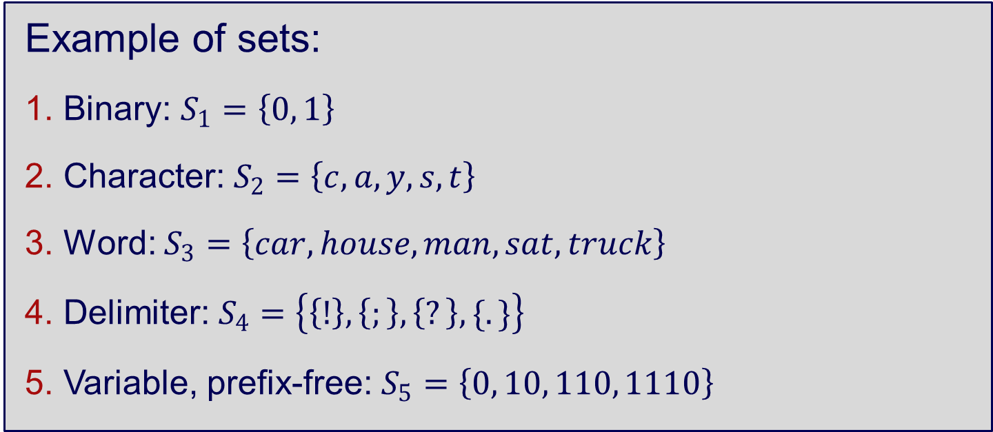
Sets
Example of sets:
Binary: $S_{1}=\left\{0, 1\right\}$
Character: $S_{2}=\left\{c, a, y, s, t\right\}$
Word: $S_{3}=\left\{car, house, man, sat, truck\right\}$
Delimiter: $S_{4}=\left\{\left\{!\right\}, \left\{;\right\}, \left\{?\right\}, \{.\}\right\}$
Variable, prefix-free: $S_{5}=\left\{0, 10, 110, 1110\right\}$

Slide 48
Sequences
A sequence is a collection of elements in which the order of the elements must be maintained, and elements can occur any number of times.
A sequence is simple a multiset in which the order is important
Typical operations: add, remove, search
In computer science, can also be referred to as a list (ordered collection of elements)

Slide 49
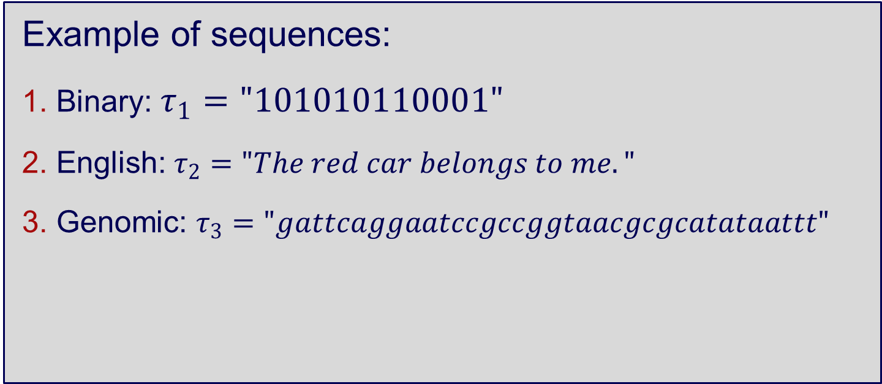
Sequences
Example of sequences:
Binary: $τ_{1}="101010110001"$
English: $τ_{2}="The red car belongs to me."$
Genomic: $τ_{3}="gattcaggaatccgccggtaacgcgcatataattt"$

Slide 50
Stack
A stack is a collection with two defining operations, push and pop.
Push adds new element at the top of the stack, and
Pop removes element at the top from the stack.
Stack ADT implements LIFO principle, i.e., Last In, First Out

Slide 51
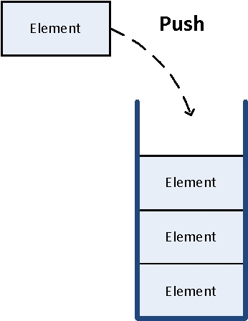
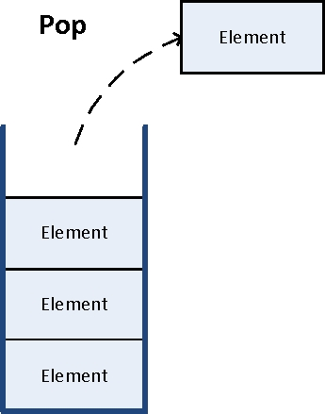
Stack – Last In First Out

Slide 52
Queue
A queue is a collection with two defining operations, enqueue and dequeue.
Enqueue adds new elements at the back of the queue, and
Dequeue removes elements at the front from the queue.
Queue ADT implements FIFO principle, i.e., First In, First Out

Slide 53
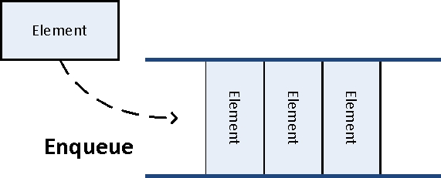
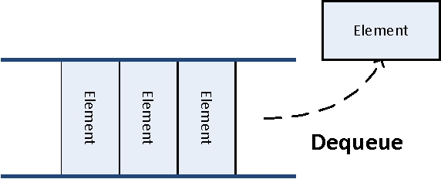
Queue – First In First Out

Slide 54
Dictionaries/Maps
A dictionary/map is a collection of (key, value) pairs, such that each key can only appear once in the dictionary/map.
Example: a dictionary of former leaders and country they led:
Key | Value
Vladimir Lenin | Soviet Union
Winston Churchill | UK
Mao Ze Dong | China
Tony Abbott | Australia

Slide 55
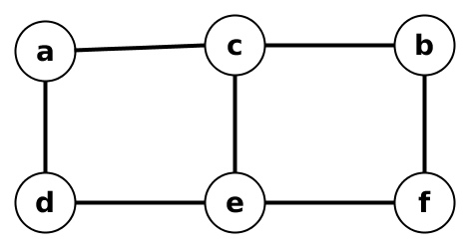
Graphs
A graph G = {V, E} is defined by a pair of two sets: a finite set V of items called vertices and a set E called edges, representing links/relations/connections between pairs of vertices.
Example:
V = {a, b, c, d, e, f}
E = {(a, d), (a, c), (d, e),
(c, e), (c, b), (e, f), (b, f)}

Slide 56
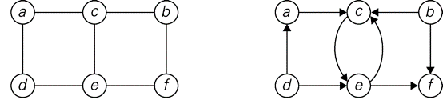
Graphs
A graph G is undirected if the edges do not have a direction, i.e., all of the pairs of vertices in E are unordered.
A graph G is directed if the edges form a direction, i.e., all of the pairs of vertices in E have an ordering imposed.

Slide 57
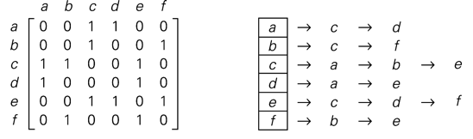
Graphs
How to represent a graph without drawing it?
Adjacency matrix and adjacency lists

Slide 58
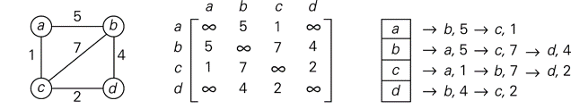
Graphs
What if edges have weights associated with them?

Slide 59
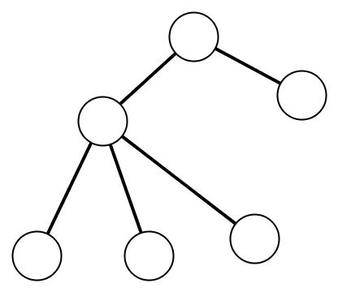
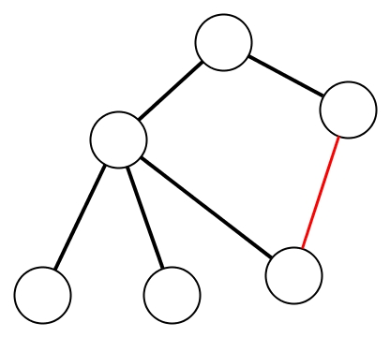
Trees
A tree is a connected acyclic graph.
Acyclic = not displaying or forming part of a cycle
Not acyclic graph
Acyclic graph

Slide 60
5. Data Structures

Slide 61
Data Structures
Now we describe several data structures that can implement different ADTs
We will learn more data structures as we progress through the course
Two important data structures are array and linked list
Both can implement many ADTs, e.g., sequences, set, dictionary

Slide 62
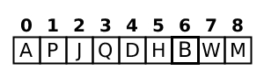
Array
Collection of elements, usually stored in a continuous manner
Fast random access – accessed by indices
Resizing can be costly (may require copying), hence often need to estimate size of array beforehand

Slide 63
Linked Lists
Each node stores element and a pointer to the next node
There is a head pointer that points to the start of the list
Sometimes there is a tail pointer that points to the end of the list
Other variants of linked list, e.g., doubly linked lists

Slide 64
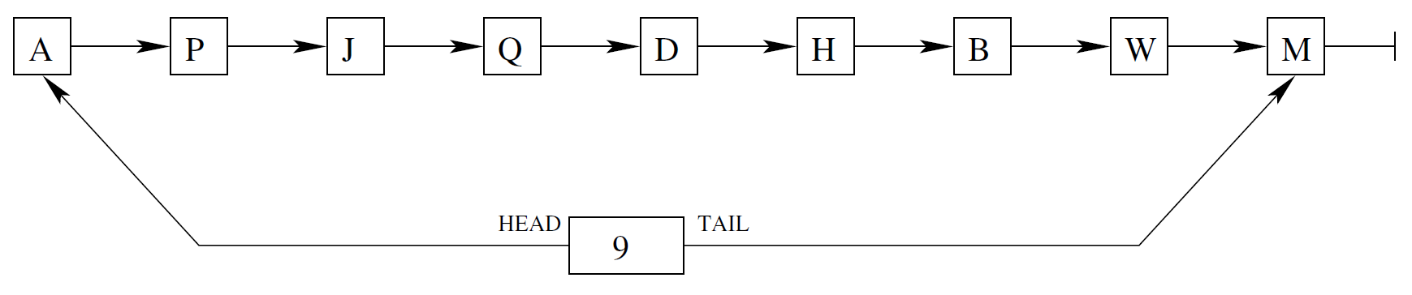
Linked Lists – insertion
Insert the elements of following sequence of letters, one by one:
[A, P, J, Q, D, H, B, W, M]
What if I wanted to insert element C between Q and D?

Slide 65
Linked Lists – deletion
Given linked list, delete B

Slide 66
To finish…

Slide 67
Learning Objectives
Understand the concept of algorithms and data structures, and the motivation behind their analysis
Algorithm is a sequence of (unambiguous) instructions/steps for solving a problem
Many applications: sorting, searching… to machine learning and deep learning

Slide 68
Learning objectives
Learn about different abstract data types and two data structures
ADT: interfaces such as set, sequence, stack, queue, graph, tree
Data structure: implementation of ADT such as array and linked list

